Slide 1
A Tableau Exploration on Movie Trends Dataset

Slide 2
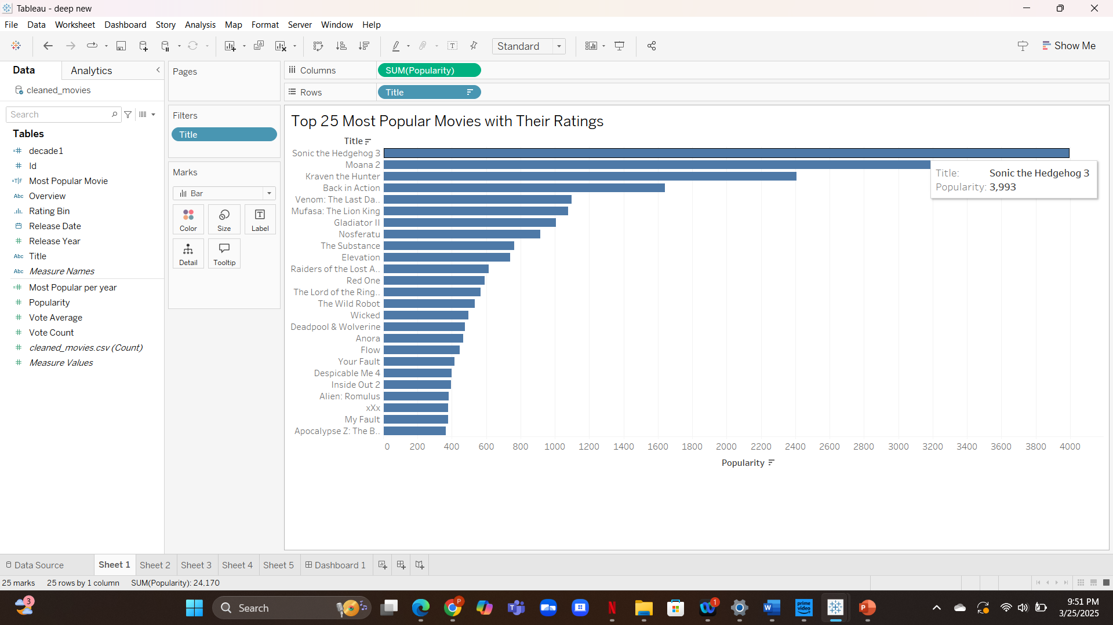
This bar chart shows the top 25 movies based on popularity from the dataset

Slide 3
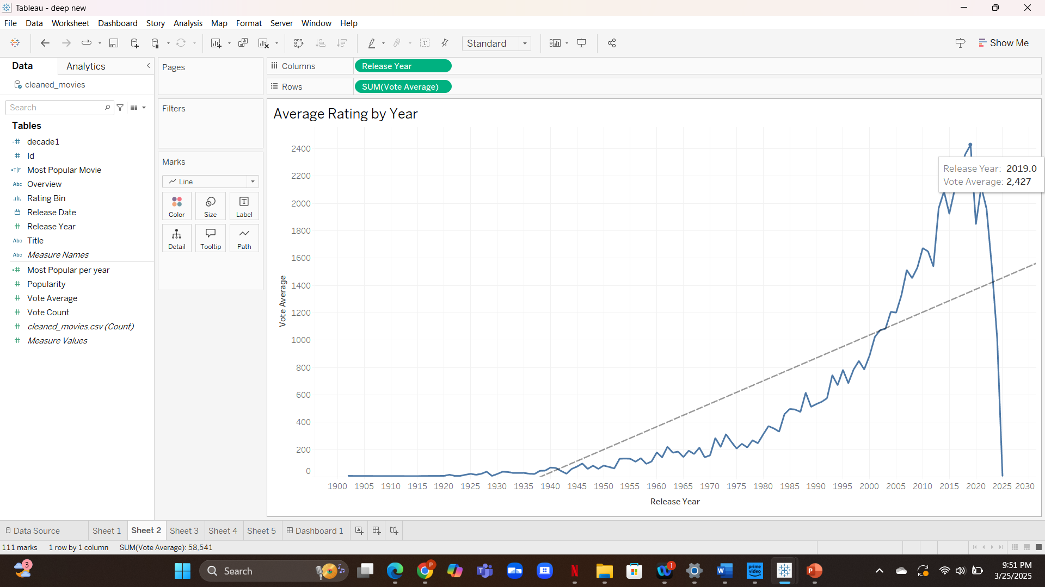
Line chart representing how average ratings have changed over the years.

Slide 4
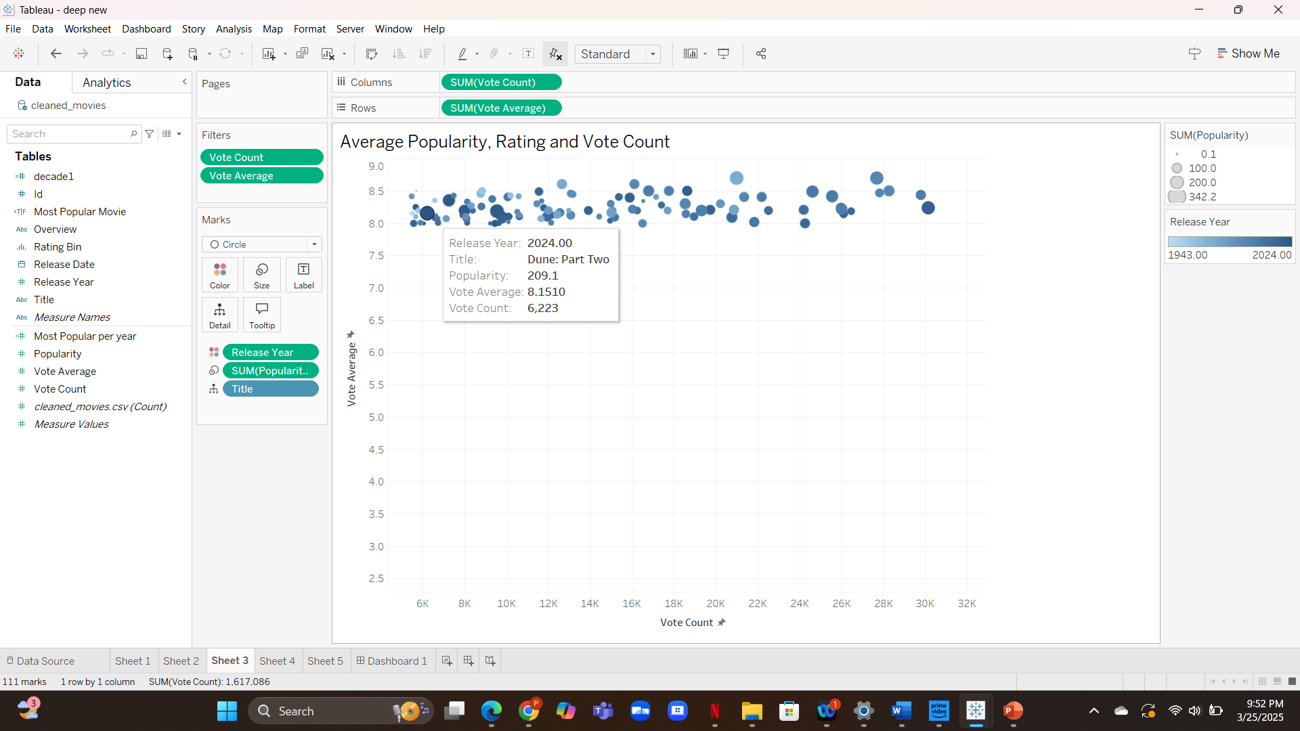
Bubble chart comparing vote count and ratings, with size representing popularity.

Slide 5
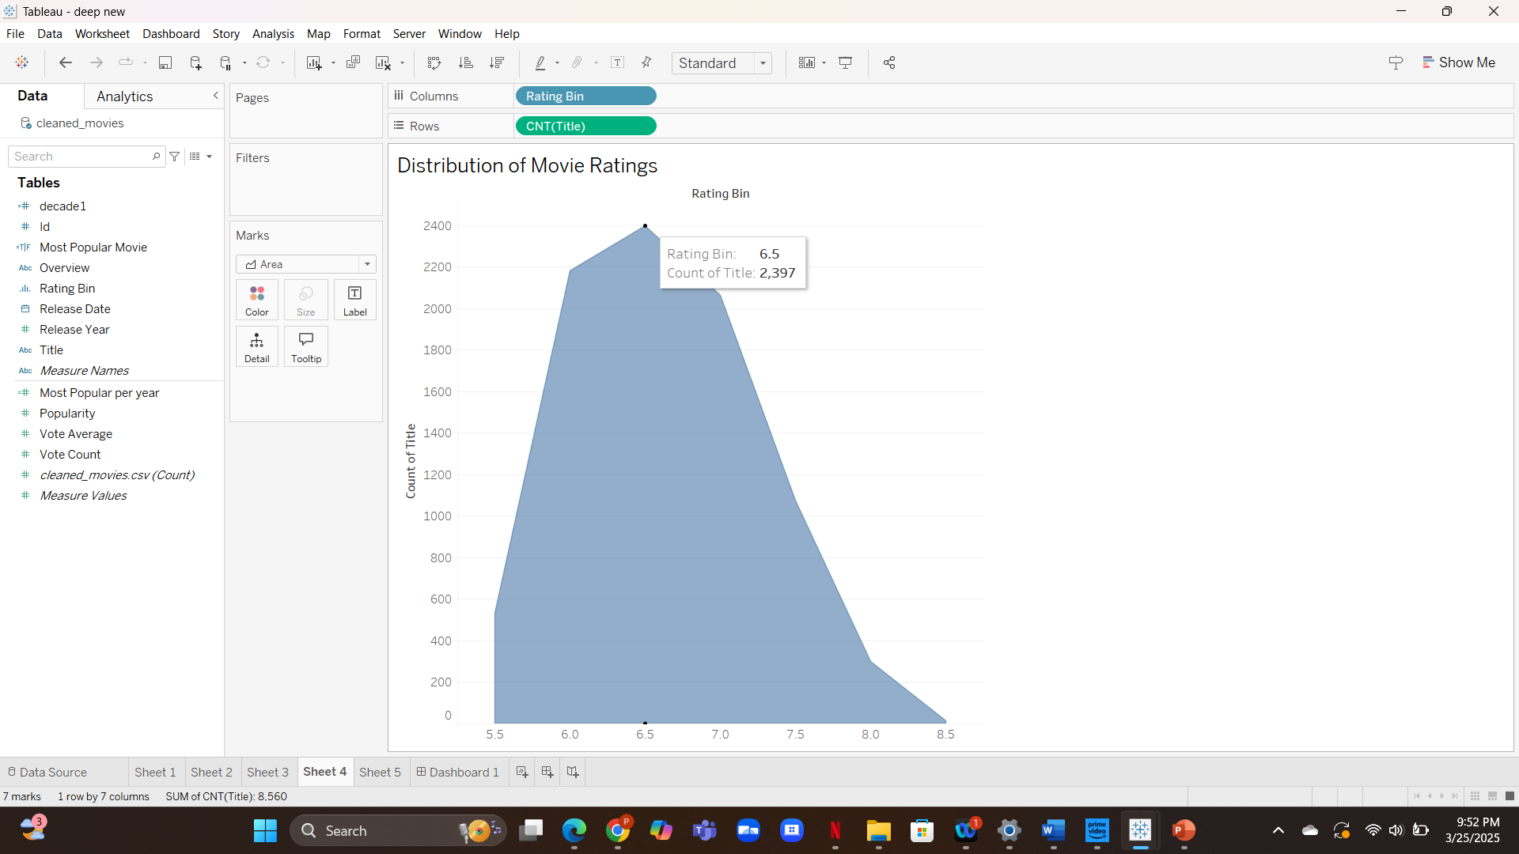
Area showing how top-rated movies are distributed across rating bins.

Slide 6
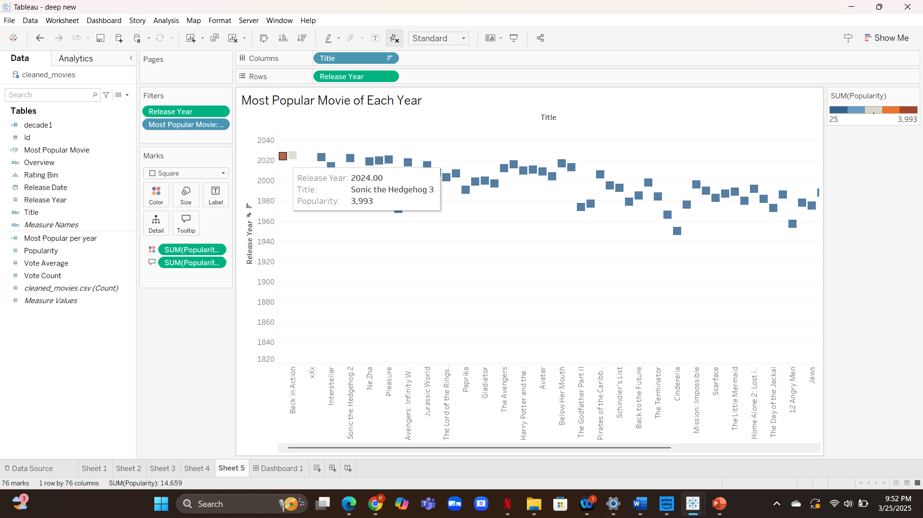
A heat map showing the most popular movie from each year based on color intensity.

Slide 7
Expected Findings
Expected: Recent movies are more popular Surprising: Some of them have very low ratings
Expected: Ratings improve with better filmmaking Surprising: Ratings are declining
Expected: Highly voted = better quality Surprising: Some low-vote movies are critically loved
Expected: Ratings are widely distributed Surprising: Most movies fall into a narrow band (6.5–7.5)
Expected: Each year has at least one hit Surprising: A few years had no clear standout movie

Slide 8
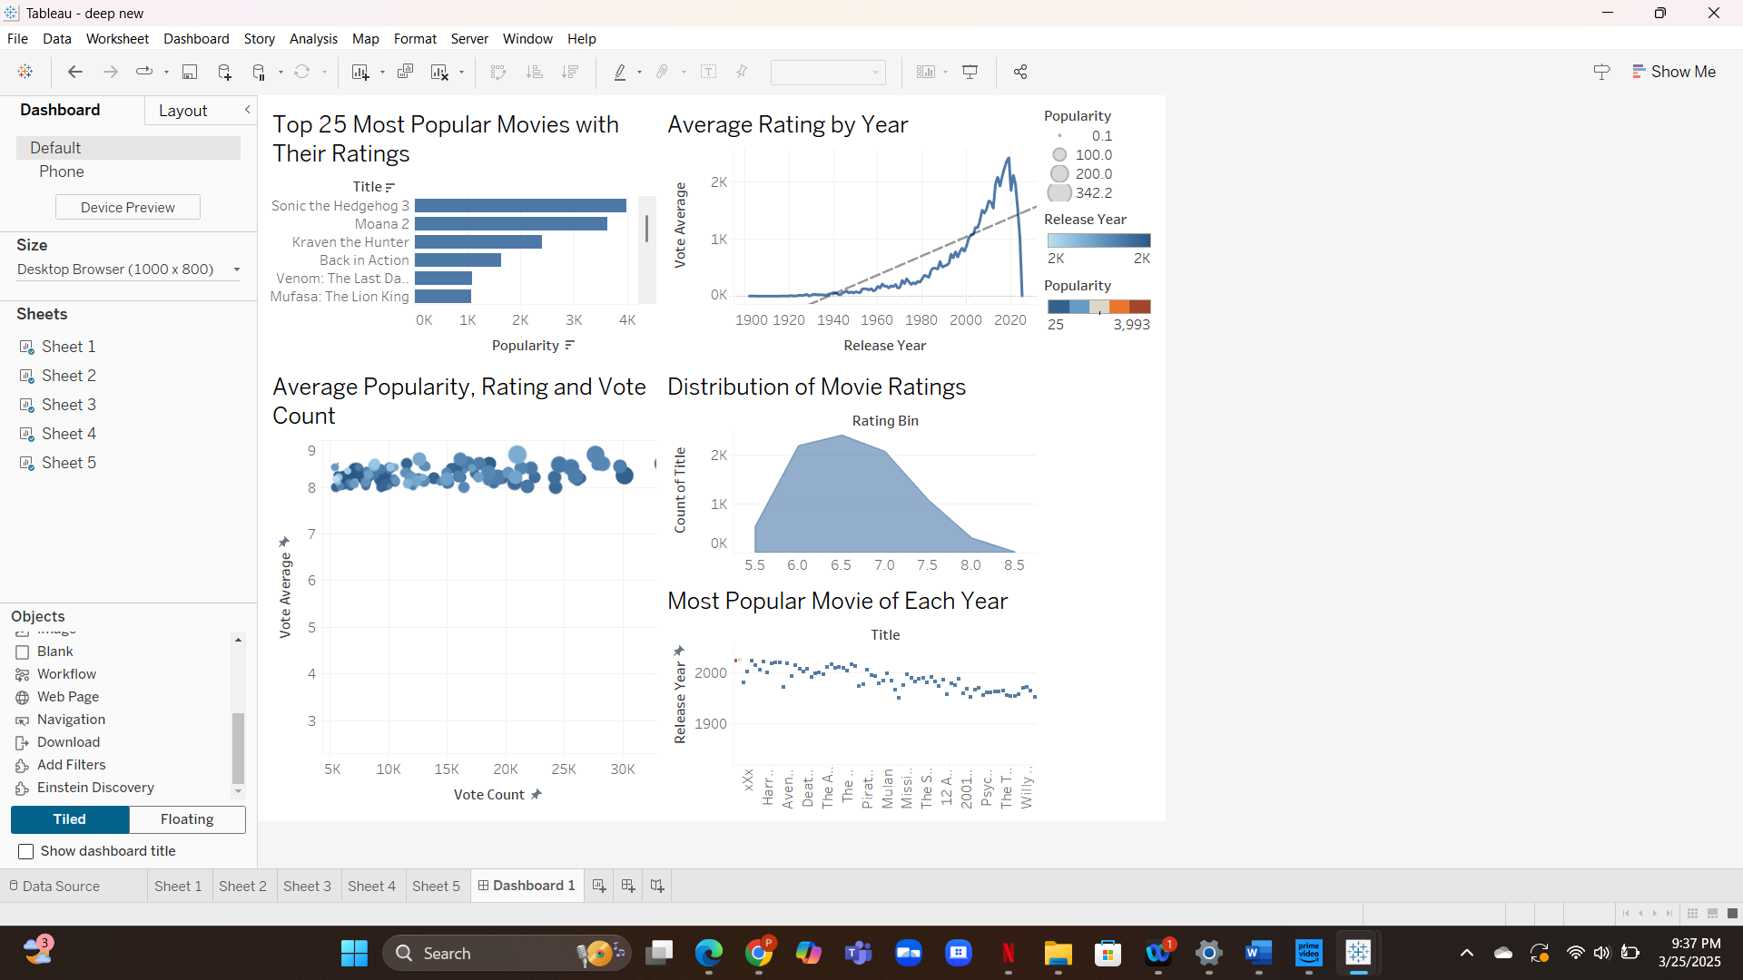
Dashboard combining all visualizations for a single, interactive overview.

Slide 9
THANKYOU

